Slide 1
ARTIFICIAL NEURAL NETWORKS:
AN INTRODUCTION
Jaya Sil
Bengal Engineering and Science University, Shibpur
Howrah-711103

Slide 2
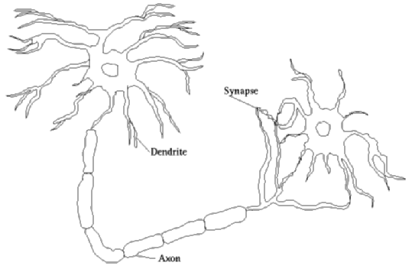
BIOLOGICAL NEURON
Cell body
In Cell body nucleus holds information
Axon emerging from the cell body carry impulses from one neuron to another.
Impulses in a neuron is received by Dendrite.
Information from one neuron flows to another neuron across a synapse.

Slide 3
INTRODUCTION
Neural networks are computational models based on the physical architecture of the brain.
Brain learns altering strength between neurons or creating/deleting connections.
ANN is new Generation of Information Processing Systems, ability to learn, recall, generalization from training data.
Neural networks can learn from data, but cannot be interpreted - they are black boxes to the user.

Slide 4
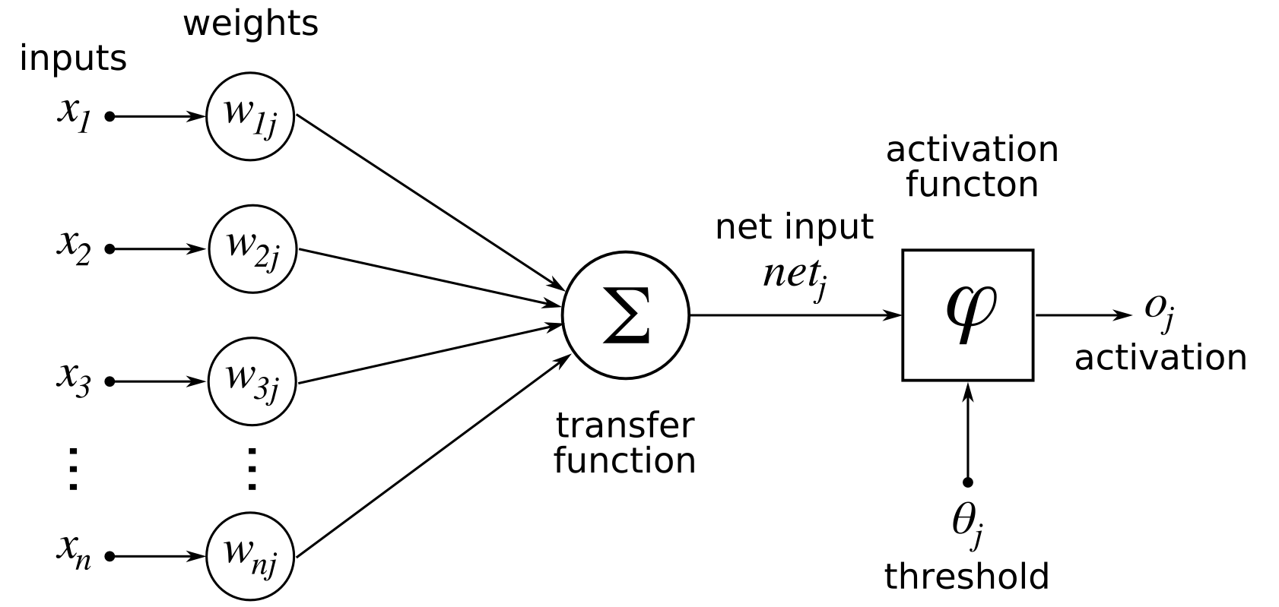

Slide 5
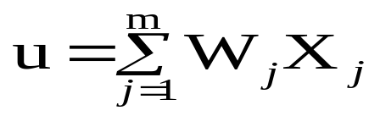
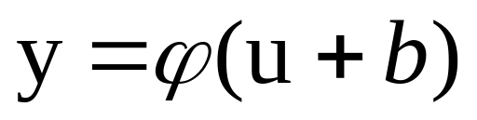
PROCESSING OF AN ANN
A set of links, describing the signal strength of neuron input with weights W₁, W₂, …, W_{m.}
An adder function for computing the weighted sum of the inputs (0 to 1)
Activation function for limiting the amplitude of the neuron output

Slide 6
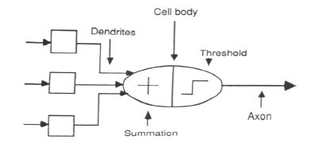
ASSOCIATION OF BIOLOGICAL NET WITH ANN

Slide 7
A simulated NN node is connected to other nodes via links
Activation function can be a threshold function. So NN node output is either 0 or 1
NN nodes learn by searching through a space of network weights
The weights used to recognize patterns

Slide 8
ANN COMPUTING
  Neurally inspired Mathematical model
  Parallel distributed computing
  Connectionist model
  Connections hold the knowledge
  Self-organization

Slide 9
Learning ability,
Generalization ability,
Adaptivity,
Inherent contextual information processing,
Fault tolerance,
The multilayer NN are universal approximators.

Slide 10
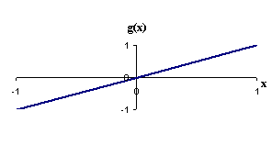
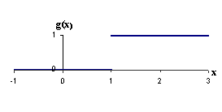
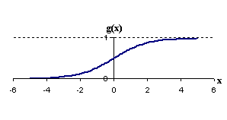
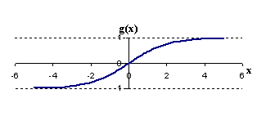


ACTIVATION FUNCTIONS
Binary step: : g(x) =1; if x≥θ
0; if x<θ
Identity: g(x)=x
Sigmoidal
Bipolar Sigmoidal

Slide 11
BIAS INPUT
Y_{in} = ∑w_{i}x_{i} + b, where b is the bias
b
x₁
∑w_{i}x_{i} + b
Y_{in}
x_{n}
Bias can be of two types (i) positive, helps to increase the net input and (ii) negative bias helps to decrease the net input

Slide 12
OPERATION OF A NEURAL NET
-
x₀
w_{0j}
x₁
w_{1j}
∑
f
Output y
x_{n}
w_{nj}
Input
vector x
Weight
vector w
Weighted
sum
Activation
function

Slide 13
TRAINING PROCEDURE
Repeat
  Present a training example to the network
  Compute the values at the output nodes
  Error = difference between observed and computed values
  Make small changes to weights to reduce the error
Until (there are no more training examples);

Slide 14
BUILDING BLOCKS OF ANN
Network Architecture
Initialization of Weights
Activation Function
Weight Adjustment Rule

Slide 15
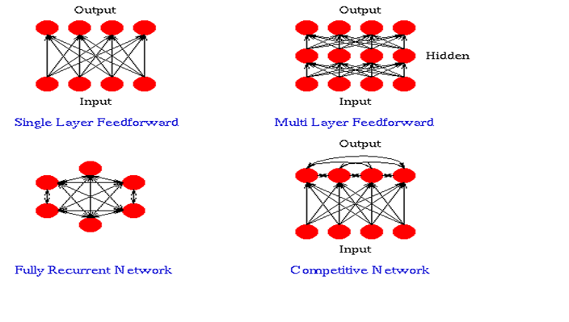

Slide 16
LAYERS
Input Layer: Each input unit holds an attribute value of an instance
Hidden Layer: Not directly observable, provides nonlinearity to the network.
Output Layer: Encodes possible values and provide output for the designated input.

Slide 17
TRAINING METHODS
Supervised Training - Providing the network with a series of sample inputs and comparing the output with the supplied desired responses.
Unsupervised Training – No Desired Response is provided.
Reinforcement Training - Right answer is not provided but indication of whether ‘right’ or ‘wrong’ is provided.

Slide 18
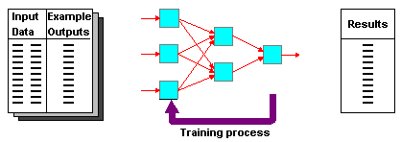
SUPERVISED LEARNING
Training and test data sets
Training set; input and target are specified

Slide 19
CHARACTERISTICS
Neural Network learns by adjusting the weights so as to be able to correctly classify the training data and hence, after testing phase, able to classify unknown data.
Neural Network needs long time for training.
Neural Network has a high tolerance to noisy and incomplete data.

Slide 20
DIFFERENT TYPES OF ANN

Slide 21
McCULLOCH–PITTS NEURON
McCULLOCH–PITTS (1943) for introducing the idea of neural networks as Computing machines.
Neurons are directly connected
Firing state is binary (1 = firing, 0 = not firing)
The weights may be excitatory (positive) or inhibitory (negative) tend to increase or decrease voltage
  Inhibitory neuron regulate network activity (prevent too many firings)

Slide 22
McCULLOH-PITTS NEURON
If the net input (y_{in}) to the neuron is greater than the threshold then the neuron fires.
The M-P neurons are used for realizing Logic functions.
It has no particular training algorithm.
1 if y_{in} ≥ θ
y =
0 if y_{in}< θ
w
y_{in}
w
y
-p
- p
- p

Slide 23
SELF ORGANIZED LEARNING
Motivated by neurobiological consideration and implemented with a set of rules of local behaviour.
Local means adjustment of synaptic weights of each neuron in the network confined to the immediate local neighborhood of the neuron.
Modification of the synaptic weights of the neuron based on presynaptic and postsynaptic signals available at the local level.
The neurobiologically motivated rules of self-organization mechanism is the very essence of Hebbian learning.

Slide 24
HEBBIAN NETWORK (1949)
When an axon of cell or neuron A excites a cell or neuron B, neuron B fires, and if this situation occurs repeatedly or persistently, then some growth process or metabolic changes take place in one or both the cells or neurons such that A’s efficiency to fire neuron B is increased.
x_{j}
y_{i}
A
B
Hebbian Hypothesis: The synaptic strength of brain changes proportionately to the correlation between the firing of the pre and postsynaptic neurons.

Slide 25
HEBBIAN LEARNING RULE
Weights are adjusted according to the pre and postsynaptic correlations.
The learning signal r = a (W_{i}^{T} X) = y_{i} is PE’s current output.
ΔW_{i} = η r X = η a (W_{i}^{T}X) X = η y_{i} X; η is positive and determines rate of learning
The components of the weight vector are updated by an amount of
Δw_{ij} = η r X = η a (W_{i}^{T}X) x_{j} = η y_{i} x_{j}
If the input-output correlation term y_{i} x_{j} is positive, the weight increases, otherwise the weight decreases

Slide 26
HEBBIAN LEARNING RULE
Hebbian Learning Rule is an unsupervised learning rule for a Feedforward Network since no Target value is supplied.
A Hebbian synapse uses a time dependent, highly local, and strongly interactive mechanism to increase synaptic efficiency as a function of the correlation between the presynaptic and postsynaptic activities.
A Hebbian synapse is called correlation synapse, the bais of learning.
Repeated application of the input signal x_{j} leads to an increase of y_{k} therefore, exponential growth finally drives the synaptic connection into saturation.

Slide 27
PERCEPTRONS (1958)
Essentially a linear discriminant
Perceptron theorem: If a linear discriminant exists that can separate the classes without error, the training procedure is guaranteed to find that line or plane.
Class1
Class2

Slide 28
PERCEPTRONS
Connectionist network proposed by Rosenblatt
Composed of nodes and weights
Linear threshold unit (LTU)
x₁
w₁
w₀
w₂
.
w₁₁
Σ
x₂
O
w₁₂
y_{in}
y
d
Σ w_{i} x_{i}
error
w_{n}
_{i=0}
{
x_{m}
w_{1m}

Slide 29
We ask for a particular output pattern d^{(k)} = [d₁^{(k)}, d₂^{(k)} ….. d_{n}^{(k)}]^{T} in response to an input pattern X ^{(k)} = [x₁^{(k)}, x₂^{(k)} ….. x_{m}^{(k)}]^{T} so that actual output y ^{(k)} = [y₁^{(k)}, y₂^{(k)} ….. y_{n}^{(k)}]^{T} to be equal to the target pattern d^{(k)} after the learning process.
y_{i}^{(k)} = a(W_{i}^{T} X^{(k)}) = a(Σ w_{ij} x_{j}^{(k)} ) = d_{i}^{(k)} , i= 1,2, …n; k =1,2, …p
j=1..m
W_{i}^{T}= [w_{i1}, w_{i2}, …. w_{im}]^{T} is the weight vector associated with PE i
m= no. of inputs, n= no. of outputs and p=no. of patterns and a(.) is the Threshold function.

Slide 30
PERCEPTRON LEARNING RULE
For simple perceptron the target output d_{i}^{(k)} can only take ±1 values.
y_{i}^{(k)} = sgn(W_{i}^{T} X^{(k)}) = d_{i}^{(k)}
The weight vector W of the i-th PE must be chosen so that the projection of pattern X^{(k)} onto it has the same sign as d_{i}^{(k)} .
Finding a hyperplane that divides inputs that have positive and negative targets.
Hyperplane: Σ_{i=1}^{m} w_{i} x_{j} + b = 0

Slide 31
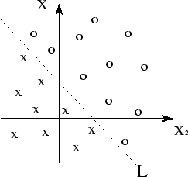
LINEAR SEPARABILITY
The input space is separated into regions and a decision line is drawn partitioning desired output = +1 from those with desired output = -1

Slide 32
y_{in} = b + x₁w₁ + x₂w₂ ;
Bipolar step activation function = 1 if y_{in} > 0 and = -1 for y_{in}< 0 and a boundary exists in between them.
Sgn(y_{in}) = d; b + x₁w₁ + x₂w₂ = 0
During training w₁, w₂ and b is to be determined.
Region:3x₁+4x₂>12
x₂
3x₁+4x₂=12
3x₁+4x₂<12 x₁

Slide 33
WEIGHT LEARNING RULE
Increment of weight at time step t is proportional to the product of learning signal r and input X(t)
ΔW_{i}(t) ∝ r X(t) or ΔW_{i}(t) = η rX(t)
Where η is learning constant and r is learning signal: r = f_{r} (W_{i}, X, d_{i})
Discrete weight vector modification:
W_{i}(t+1) = W_{i}(t) + η f_{r} (W_{i}(t), X(t), d_{i}(t)) X(t)
Continuous weight modification:w
dW_{i}(t) / dt = η r X(t)
Weight learning rule focuses on how the learning signal r is being generated to modify or update the weights of an ANN.

Slide 34
PERCEPTRON LEARNING
The learning signal r = d_{i} – y_{i} and y_{i} = sgn(W_{i}^{T} X)
Δw_{ij} = η [d_{i} - sgn(W_{i}^{T} X)] x_{j} = 2 η d_{i} x_{j} if y_{i} ≠ d_{i}, otherwise 0
The weights are adjusted only when the actual output disagree with the desired output.
w_{ij} (new) = w_{ij} (old) + Δw_{ij}
Where d is the target value, y is the perceptron output, η is a small constant (e.g., 0.1) called learning rate.
The output signals are binary

Slide 35
TRAINING ALGORITHM
The purpose is to learn the features for both classes.
The algorithm converges to the correct classes
  if the training data is linearly separable
  η is sufficiently small positive number and limited to the range 0 < η <= 1
  If η is constant independent of the iteration then we have a fixed independent adaptation rule for the perceptron.

Slide 36
ADAPTIVE CONTROL OF THE LEARNING RATE
The learning rate η is high then the speed of convergence is fast, resulting large fluctuations around the local or global minima.
Conversely low η value reduces speed of convergence though fluctuation is small.
W(t+1)=W(t) - η(t) f((X(t+1), d(t+1); W(t))
r(t+1) = r(t) + δ f(X(t+1), d(t+1); W(t)) where 0 < δ < 1
η(t+1) = η(t) + αη(t) (β || r(t+1)|| - η(t))
α and β are positive constants.

Slide 37
CROSS VALIDATION
The available data set is randomly partitioned into a training set and test set.
The training set is further divided into two disjoint subsets:
  An estimation subset, used to select the model
  A validation subset, used to test or validate the model.
  Validation data set is used for fine tuning the parameters in order to choose the best model.
  Generalization performance of the selected model is measured on the test set.
  Cross validation is appealing for large neural network with good generalization of the goal.

Slide 38
THE PERCEPTRON AND BAYES CLASSIFIER
The operation of the Bayes classifier for the Gaussian environment is analogous to that of the perceptron as both are linear classifiers.
Differences: In case of perceptron the patterns to be classified are linearly separable.
The Gaussian distribution of two patterns in case of Bayes classifier certainly overlap each other and therefore, not separable.
The extent of overlap is determined by the parameters (mean vector and covariance matrix).

Slide 39
OVERLAPPING DISTRIBUTIONS
When patterns are nonseparable and distributions overlap, the perceptron convergence algorithm develops a decision boundary which oscilate between the two classes.
The Bayes classifier minimizes the probability of classification error, independent of overlap phenomena.
w₁ w₂
p(error | x) = p(w₁| x) or p(w₂ | x) if we decide w₂ or decide w₁

Slide 40
WIDROW-HOFF’S ADALINE (ADAPTIVE LINEAR ELEMENT)
  First linear adaptive filtering algorithm for solving problems of prediction.
  Neuron with continuous and differentiable activation functions.
  ADALINE learning law follows Least Mean Square (LMS) rule or Widrow-Hoff rule or delta rule developed by Widrow and Hoff (1960)
  ADALINE uses bipolar training patterns and algorithm is based on a single linear neuron with adjustable weights, limits the computational power of the algorithm

Slide 41
ADALINE LEARNING RULE
  For individual input pattern X^{(k)} the change of weight.
Δw_{j} = η(d^{(k)} – W^{T} X^{(k)}) x_{j}^{(k) -} called Adaline learning rule or Widrow-Hoff learning rule.
Uses Linear Activation function, a(net) = net
Computational complexity of the algorithm is linear w.r.t. the number of adjustable parameters.

Slide 42


Gradient Descent Method
  To find the weights, a cost function or loss function J(w) is defined, which measures the error (MSE).
  J(w) = ½ ∑ (d^{(k)} – y^{(k)})² = ½ ∑ (d^{(k)} – W^{T} X^{(k)})²
  k=1..p k=1…p
  Δw_{j} = -η ∂ E / ∂ w_{j} = - η ∑(d^{(k)} – w^{T} X^{(k)})x_{j}^{(k)}; j=1 … m
  k=1..p
  Gradient-descent algorithm suggests adjusting each weight w_{i} by an amount Δw_{i} proportional to the negative of the gradient of J(w) at the current location.
predicted
actual

Slide 43
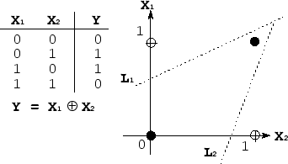
The XOR problem
Multiple layers of perceptrons solve this problem.
A typical multi-layered system minimizes LMS Error

Slide 44
Linearly nonseparable problem is transformed to a linearly separable problem by space transformation.
X⁽¹⁾ = [0 0]^{T}, d⁽¹⁾ =1; X⁽²⁾ = [0 1]^{T}, d⁽²⁾ = -1
X⁽³⁾ = [1 0]^{T}, d⁽³⁾ = -1; X⁽⁴⁾ = [1 1]^{T}, d⁽⁴⁾ =1
Arbitrarily use two lines to partition the input space into three subspaces. x₂ x₁-x₂+0.5 = 0
x₁-x₂ - 0.5 = 0
x₁
Two selected lines: x₁ – x₂ + 0.5 = 0 and x₁ – x₂ – 0.5 = 0

Slide 45
Two LTU are used to perform the partition.
Outputs: z₁ = sgn(x₁ – x₂ + 0.5) and z₂ = sgn(x₁ – x₂ – 0.5)
Two LTUs are put in the hidden layer (z space).
x₁ 1 z₁
-1 1
x₂ -0.5 1
-1 -1
-1 0.5 z₂ -1 0.5
LTU
LTU
y
LTU

Slide 46
The transformed Training Patterns:
Z⁽¹⁾ =[1 -1]^{T}, d⁽¹⁾ =1; Z⁽²⁾ = [0 1]^{T}, d⁽²⁾ = -1;
Z⁽³⁾ = [1 1]^{T}, d⁽³⁾ = -1; Z⁽⁴⁾ = [1 -1]^{T}, d⁽⁴⁾ =1
z₂
Z⁽³⁾
1 z₁-z₂ - 0.5=0
-1
1
z₁
Z⁽²⁾
Z⁽¹⁾ = Z⁽⁴⁾
-1
The original input patterns X⁽¹⁾ and X⁽⁴⁾ coincides in Z space.
y = sgn(z₁-z₂-0.5)

Slide 47

MULTI-LAYER PERCEPTRON
INPUT VECTOR: X = { x₁, x₂, …, x_{n}}, n is the number of attributes.
INPUT LAYER: number of nodes equal to the number of
attributes.
HIDDEN LAYER: the number of nodes in the hidden
layer and the number of hidden layers depends on implementation issues.
w_{ij} is the weight on the synapse from
j-th neuron to i-th PE neuron.

Slide 48
MULTI-LAYER PERCEPTRON
Each neuron in the network includes a nonlinear activation function that is differentiable.
In supervised learning, at each instant of time when input is applied to an ANN, the corresponding desired response d is given.
Sequence of samples (X¹,d¹), (X²,d²)…. (X^{k},d^{k}),
k =1, 2…, p (number of training samples)

Slide 49
WEIGHT UPDATION
Per Sample Updating
- updating weights after presentation of each sample.
Per Training Set Updating (Epoch or Iteration)
- weights updated after all the samples of the training set have been presented.
The MLP can theoretically perform “any” input-output mapping.
Can learn to solve linearly inseparable problems.

Slide 50
TERMINATION
Change in weights (Δw_{ij}) in the previous epoch are below some threshold, or
A pre-specified number of epochs has expired.
In practice, several hundreds of thousands of epochs may be required before the weights will converge.

Slide 51
HIDDEN NEURONS
Hidden neurons act as feature detectors.
Neurons perform a nonlinear transformation on the input data into a new space called feature space.
Hidden neurons gradually discover the salient features that characterize the training data.

Slide 52
BUILDING ANN
Determine the network properties:
  Network topology
  Types of connectivity
  Order of connections
  Weight range
Determine the node properties:
  Activation range
Determine the system dynamics
  Weight initialization scheme
  Activation function and cost function
  Learning rule

Slide 53
BACK PROPAGATION ALGORITHM
Algorithm is applied to multilayer feedforward networks.
Processing elements with continuous differentiable Activation Functions.
Weight updation rule is based on Gradient Descent method.
For a given input-output pair (x^{(k)}, d^{(k)} ), the algorithm performs two phases of data flow.

Slide 54
BACK PROPAGATION
m PEs in the input layer, l PEs in the hidden layer and n PEs in the output layer
Inputs
x_{j} v_{qj} z_{q}
w_{iq} y_{i}
y_{n}
x_{m}
Hiddens
I₀
Outputs
h₀
I₁
o₀
h₁
I₂
o_{n}
h_{l}
Outputs
I_{m}
Hiddens
Inputs

Slide 55
Given an input X, a PE q in the hidden layer receives a net input of net_{q} = ∑_{j} v_{qj} x_{j} and
Produces an output z_{q} = a(net_{q}) = a(∑_{j} v_{qj} x_{j})
The net input for a PE i in the output layer is
net_{i} = ∑_{q} w_{iq} z_{q} = ∑_{q} w_{iq} a(∑_{j} v_{qj} x_{j} ) and
Produces an output of y_{i} = a(net_{i}) = a ∑_{q} w_{iq} z_{q} = a (∑_{q} w_{iq} a(∑_{j} v_{qj} x_{j}) )

Slide 56
PERCEPTRON AND SIGMOID NEURON
Let net = w ⋅ x + b is a large positive number.
Then e^{− net} ≈ 0 and so σ(net) ≈ 1,
The output from the sigmoid neuron is approximately 1, just as it would have been for a perceptron.
Suppose net = w ⋅ x + b is large negative.
Then e^{− net} → ∞, and σ(net) ≈ 0. The behaviour of a sigmoid neuron also closely approximates a perceptron.
It's only when w ⋅ x + b is of modest size, sigmoid model has much deviation from the perceptron model.

Slide 57
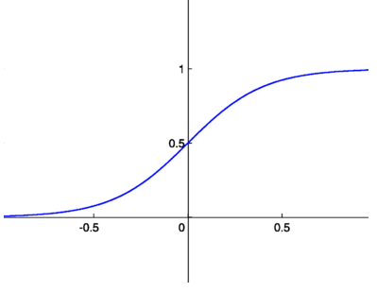
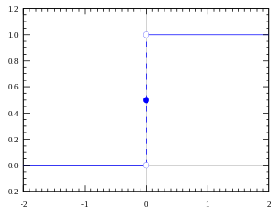
SIGMOID FUNCTION
Sigmoid function σ is a smoothed version of a step function:
If σ had been a step function, then the sigmoid neuron would be a perceptron neuron.

Slide 58
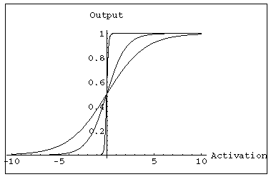
ACTIVATION AND TRAINING
  A continuous function can be
  differentiated allowing
  gradient-descent.
  Backpropagation Algorithm pioneered by Rumelhart
  allows gradient-descent in multilayer feedforward network
  Uses sigmoid (binary or bipolar) activation function.

Slide 59

Smoothness of Sigmoid Function
The smoothness of σ: small changes Δw_{j} in the weights and Δb in the bias produce a small change Δoutput .
Δoutput is a linear function of Δw_{j} and Δb
Linearity makes it easy to choose small changes in the weights and biases to achieve any desired small change in the output.
Sigmoid neurons make it much easier to figure out how changing the weights and biases will change the output.

Slide 60

Gradient Descent
Training input x: a 28 × 28 = 784 dimensional vector.
Desired Output = y(x) = (0,0,0,0,0,0,1,0,0,0)^{T} for a particular training image which depicts ‘6’
Find weights and biases so that the output ‘a’ from the network (‘a’ depends on x, w and b) approximates y(x) for all training input x by minimizing the MSE cost function
The algorithm is known as gradient descent.
predicted
Actual

Slide 61
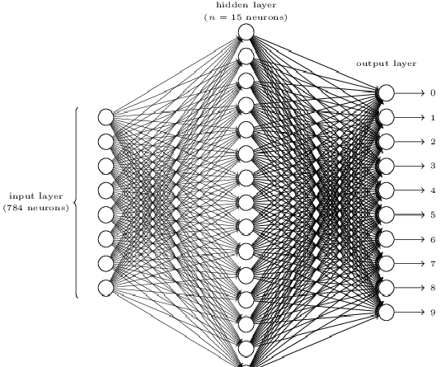

Slide 62
COST FUNCTION: WHY INTRODUCE THE QUADRATIC COST FUNCTION?
Why not try to maximize the number of images correctly classified as the cost function?
The number of images correctly classified is not a smooth function of the weights and biases in the network.
It is difficult to figure out how to change the weights and biases to get improved performance.
Use a smooth cost function like the quadratic cost it turns out to be easy to figure out how to make small changes in the weights and biases so as to get an improvement in the cost.

Slide 63
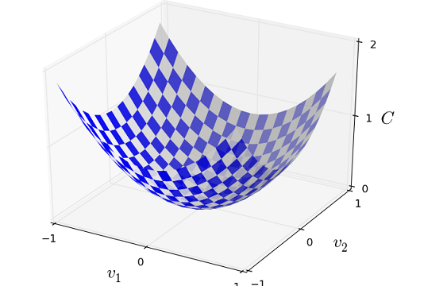
MINIMIZING COST FUNCTION
C(v1, v2)
May use calculus to try to find the minimum analytically.
It might work for C as a function of just one or a few variables, but not for many more variables.
In neural networks cost functions depend on billions of weights and biases.
An extremely complicated way using calculus to minimize that and just won't work!

Slide 64

GRADIENT VECTOR
Move the ball a small amount Δv₁ in the v₁ direction, and a small amount Δv₂ in the v₂ direction. Simulate by computing derivative of ’C’
Find a way of choosing Δv₁ and Δv₂ to make ΔC negative; i.e., choose them so the ball is rolling down into the valley.
Define Δv to be the vector of changes in v, Δv ≡ (Δv₁, Δv₂)^{T}
Define the gradient of C to be the vector of partial derivatives, (∂C/∂v₁, ∂C/∂v₂)^{T}.
Denote the gradient vector by ∇C≡ (∂C/∂v₁, ∂C/∂v₂)^{T}.

Slide 65
ΔC ≈ ∇C . Δv
How to choose Δv so as to make ΔC negative.
Suppose Δv = − η∇C
η is a small, positive parameter (known as the learning rate).
ΔC ≈ − η ∇C⋅∇C = − η ∥∇C∥²
Because ∥∇C∥² ≥ 0, this guarantees that ΔC ≤ 0, i.e., C always decreases, never increases, if we change v: Δv = − η∇C
Move the ball's position v by amount Δv

Slide 66
v → v′ = v − η∇C
Use this update rule again, to make another move and keep doing this, decreasing C until - a global minimum is reached.
The gradient descent algorithm repeatedly compute the gradient ∇C, and then to move in the opposite direction, "falling down" the slope of the valley.
Learning rate η to be small enough but not to be too small, since that makes the changes Δv tiny, and thus the gradient descent algorithm works very slowly.
In practical implementations, η is often varied so that change of cost a good approximation, but the algorithm is n't too slow.

Slide 67
THE SIZE OF THE MOVE
Make a move Δv in “position” so as to decrease C as much as possible. This is equivalent to minimizing ΔC ≈ ∇C ⋅ Δv
Constrain the size of the move so that ∥Δv∥ = ϵ for ϵ > 0.
Find the movement direction with a move of small step, fixed size, which decreases C as much as possible.
It can be proved that the choice of Δv which minimizes
∇C ⋅ Δv is Δv = − η∇C, where η = ϵ / ∥∇C∥ is determined by the size constraint ∥Δv∥ = ϵ.
So gradient descent can be viewed as a way of taking small steps in the direction which does the most to immediately decrease C.

Slide 68
MANY VARIABLES
Suppose C is a function of m variables v₁,…,v_{m}
ΔC is produced by a small change Δv = (Δv₁,…,Δv_{m})^{T}
ΔC ≈ ∇C ⋅ Δv
The gradient vector ∇C:
∇C ≡ (∂C/∂v₁, ∂C/∂v_{2,} ….. ∂C/∂v_{m})^{T} and Δv =− η∇C
ΔC will be negative, a way of following the gradient to a minimum, even when C is a function of many variables

Slide 69
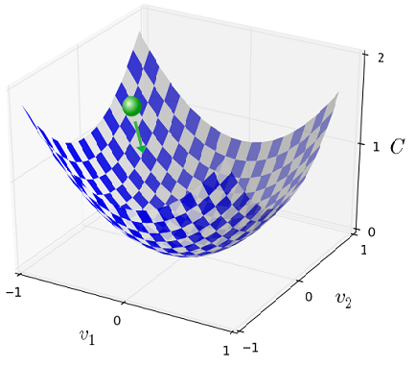
Find a minimum for the function
Assume the cost function as a kind of a valley.
Imagine a ball rolling down the slope of the valley and eventually roll to the bottom of the valley.
Randomly choose a starting point for the ball, and then simulate the motion of the ball as it rolled down to the bottom of the valley.

Slide 70
Forward Propagation of Input Signal
E(W) = ½ Σ (d_{i}-y_{i})² = 1/2Σ [d_{i} – a(net_{i})]²
⁼ ½ Σ [d_{i} – a(Σw_{iq} z_{q})]²
^{i q}
Gradient descent method: Weights between hidden to output layer are updated by
Δw_{iq} = -η∂E/∂w_{iq}
Δw_{iq} = -η[∂E/∂y_{i}][∂y_{i}/∂net_{i}][∂net_{i}/∂w_{iq}]
= η[d_{i}-y_{i}][a′(net_{i})][z_{q}] = ηδ_{oi}z_{q}
δ_{oi} is the error signal at i-th node of output layer.

Slide 71
δ_{oi} = -∂E/∂net_{i} = -[∂E/ ∂y_{i}] [∂y_{i}/∂net_{i}] = [d_{i}-y_{i}][a′(net_{i})]
Weight update between connections of input to hidden layer
Δv_{qj} =-η[∂E/∂v_{qj}] =-η[∂E/∂net_{q}] [∂net_{q}/∂v_{qj}] =-η[∂E/∂z_{q}] [∂z_{q}/∂net_{q}] [∂net_{q}/∂v_{qj}]
Δv_{qj}= η∑[(d_{i} - y_{i}) a′(net_{i}) w_{iq}] a′(net_{q}) x_{j}
Δv_{qj}= η∑[(d_{oi}w_{iq})a′(net_{q}) x_{j}= ηδ_{hq} x_{j}

Slide 72
GENERALIZED DELTA LEARNING RULE
δ_{hq} is the error signal of PE q in the hidden layer determined in terms of the error signal δ_{oi} of the PEs, y_{i} that it feeds.
δ_{hq} =-∂E/∂net_{q}=-[∂E/ ∂z_{q}][∂z_{q}/∂net_{q}]=a′(net_{q}) ∑_{i}δ_{oi}w_{iq}
net_{q} is the input to the hidden PE q.
The update rule is local, because to compute the weight change for a given connection, we need only quantities available at both ends of that connection.

Slide 73
LEARNING CURVE
Back propagation learning algorithm for MLP may be viewed as the application of a recursive technique known as stochastic approximation.
Number of epoches
Error

Slide 74
BACK PROPAGATION ALGORITHM
  The weights are updated using gradient descent method.
  Δw = - η ∂ E/ ∂ w
  Forward Propagation
  Output error measure
  Error back-propagation
  One epoch looping
  Total error checking
  Convergence issues:
  initial weight, learning constant, update rule, cost function, Momentum, architecture, size and nature of the patterns.

Slide 75
A complex pattern classification problem cast in a high dimensional space nonlinearly is more likely to be linearly separable than in a low dimensional space.

Slide 76
Radial Basis Function neural network
The radial basis function (RBF) NN is used for functional approximation, developed by M.J.D. Powell.
RBF networks have a fundamentally different architecture than most neural network architectures.
Most neural network architecture consists of many layers and introduces nonlinearity by repetitively applying nonlinear activation functions.
RBF network on the other hand only consists of an input layer, a single hidden layer, and an output layer.

Slide 77
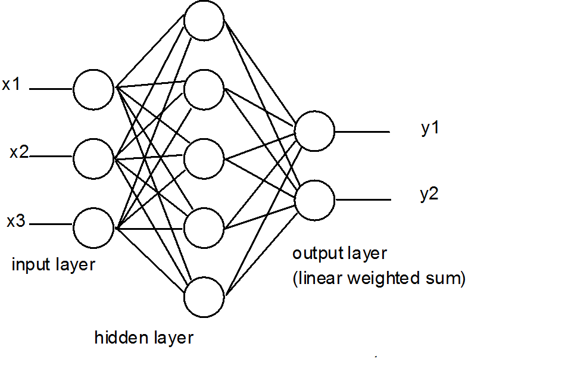

Slide 78
Radial basis function (RBF) networks
The power of the RBF network comes from the hidden layer.
The second or hidden layer performs a non-linear mapping from the input space into a (usually) higher dimensional space in which the patterns become linearly separable.
The hidden layer has higher dimensionality than the input layer because the pattern that is not linearly separable often needs to be transformed into higher-dimensional space to be more linearly separable.

Slide 79
This is based on Cover’s theorem on the separability of patterns, which states that a pattern that is transformed into a higher-dimensional space with nonlinear transformation is more likely to be linearly separable, therefore the number of neurons in the hidden layer should be greater than the number of the input neuron.
The final layer performs a simple weighted sum with a linear output, i.e. prediction task such as classification or regression.

Slide 80

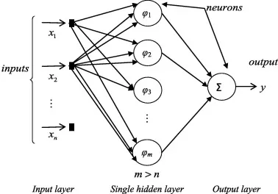
We apply non-linear transfer function to the feature vector before we go for classification problem.
⁃ When we increase the dimension of the feature vector, the linear separability of feature vector increases.

Slide 81
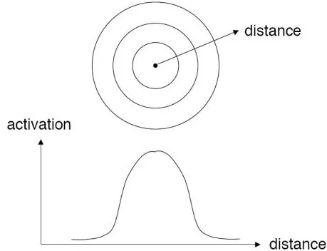
Cover’s Theorem
What is a Radial Basis Function ?
define a receptor = t
draw confrontal maps around the receptor.
⁃ Gaussian Functions are generally used for Radian Basis Function(confrontal mapping). So we define the radial distance r = ||x- t||.

Slide 82
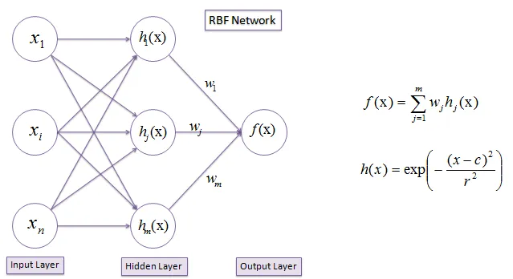
Gaussian Radial Function :=
ϕ(r) = exp (- r²/2σ²)
Radial basis functions are used as activation functions. The output of the network is a linear combination of radial basis functions of the inputs and neuron parameters.

Slide 83
Training the RBNN :-
First, train the hidden layer using back propagation.
The first stage of training is done by clustering algorithm.
⁃ For each of the node in the hidden layer, we find t (receptors) & the variance (σ) [variance — the spread of the radial basis function]
⁃ On the second training phase, update the weighting vectors between hidden layers & output layers.

Slide 84
In hidden layers, each node represents each transformation basis function.
Any of the function could satisfy the non-linear separability OR even combination of set of functions could satisfy the non-linear separability.
⁃ So in our hidden layer transformation, all the non-linearity terms are included. Say like X² + Y² + 5XY ; its all included in a hyper-surface equation(X & Y are inputs).

Slide 85
Define the number of cluster centers and by clustering algorithm, we compute the cluster centers, which then is assigned as the receptors for each hidden neurons.
Cluster N samples or observations into M clusters (N > M).
The output “clusters” are the “receptors”.
For each receptors, find the variance as “the squared sum of the distances between the respective receptor & the each cluster nearest samples” := 1/N * ||X — t||²
The interpretation of the first training phase is that the “feature vector is projected onto the transformed space”.

Slide 86
Clustering
The unique feature of the RBF network is the process performed in the hidden layer.
The idea is that the patterns in the input space form clusters.
If the centres of these clusters are known, then the distance from the cluster centre can be measured.
Furthermore, this distance measure is made non-linear, so that if a pattern is in an area that is close to a cluster centre it gives a value close to 1.
In a RBF network, r is the distance from the cluster centre.

Slide 87
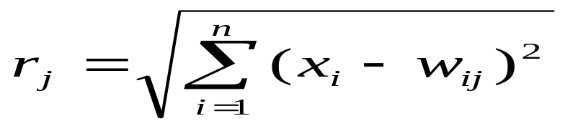
Clustering
Beyond this area, the value drops dramatically.
This area is radially symmetrical around the cluster centre, so the non-linear function known as the radial-basis function.
The distance measured from the cluster centre is usually the Euclidean distance.
For each neuron in the hidden layer, the weights represent the co-ordinates of the centre of the cluster.
When that neuron receives an input pattern, X, the distance is measured.

Slide 88
Learning
In the first step, the center vectors c_{i} of the RBF functions in the hidden layer are chosen.
Centers can be randomly sampled from some set of examples,
Can be determined using k-means clustering. Note that this step is unsupervised.

Slide 89
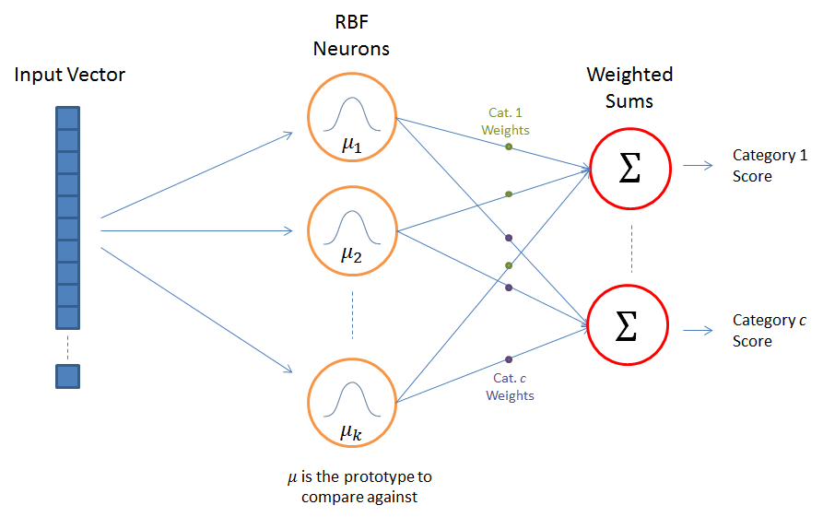
Output nodes form a linear combination of the kernel functions computed by RBF nodes or hidden layer nodes.
The kernel functions in the hidden layer produces a significant nonzero response to the input which fall within a small region.
Only inputs near a receptive field produce an activation

Slide 90
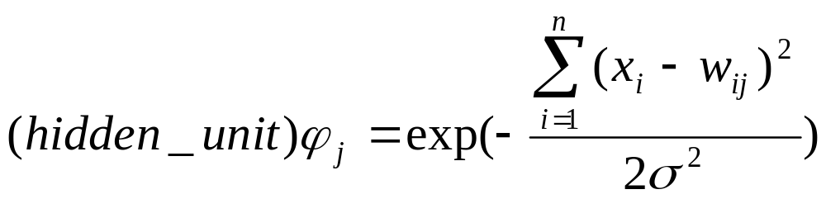
Width of hidden unit basis function
The variable sigma, σ, defines the width or radius of the bell-shape.

Slide 91
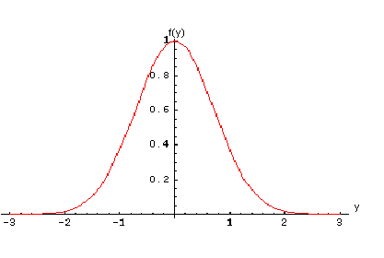
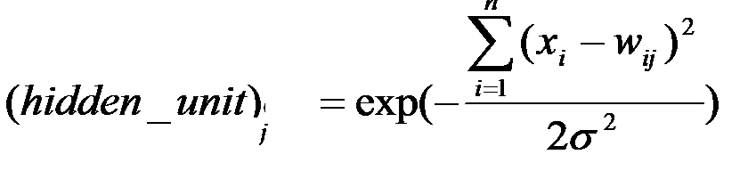
The output of the mapping is a linear combination of the basis functions.
The notion is that this area is radially symmetrical around the cluster centre, so that the non-linear function becomes known as the radial-basis function.
The network uses sigmoidal and Gaussian kernel functions to handle nonlinearly inseparable problems.
The Gaussian function:

Slide 92
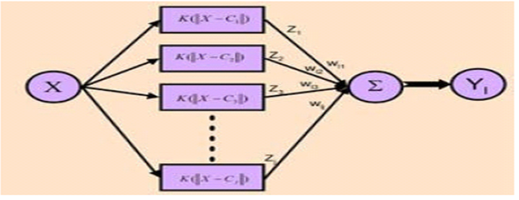
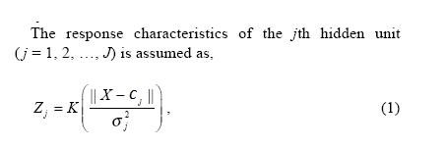

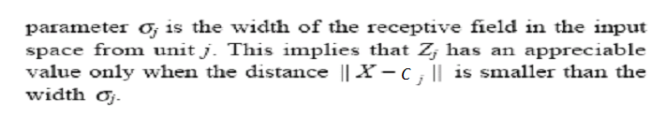

Slide 93
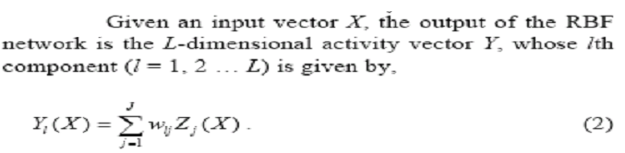

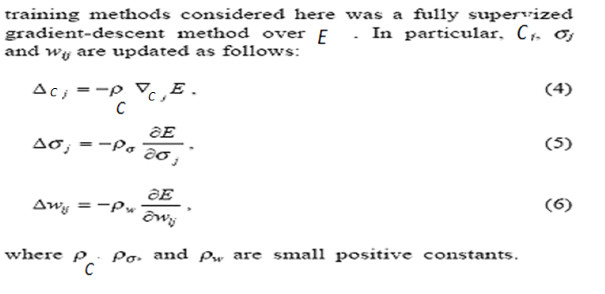

Slide 94
Characteristics
The RBF Mapping
The RBF Network Architecture
RBF NN can be treated as a non-linear classifier.
An RBF NN performs classification by measuring the input’s similarity to examples from the training set.
Training an RBF Network
Unsupervised Optimization of the Basis Functions
Computing the Output Weights
Supervised RBF Network Training

Slide 95
XOR function :-
4 inputs and do not increase dimension at the feature vector. So select 2 receptors.
For each transformation function ϕ(x), we will have each receptors t.
Now consider the RBNN architecture,
P := # of input features/ values.
M = # of transformed vector dimensions (hidden layer). So M ≥ P usually be.
Each node in the hidden layer, performs a set of non-linear radian basis function.
Output C will remains the same as for the classification problems(certain number of class labels as predefined).

Slide 96
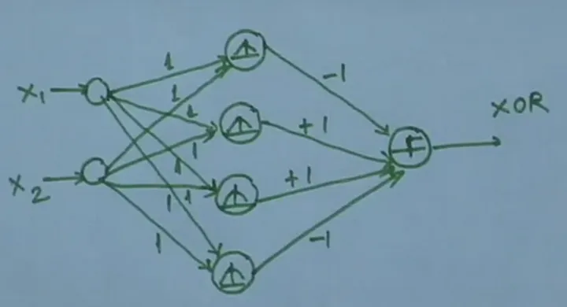
Weights are Randomly Initialized

Slide 97
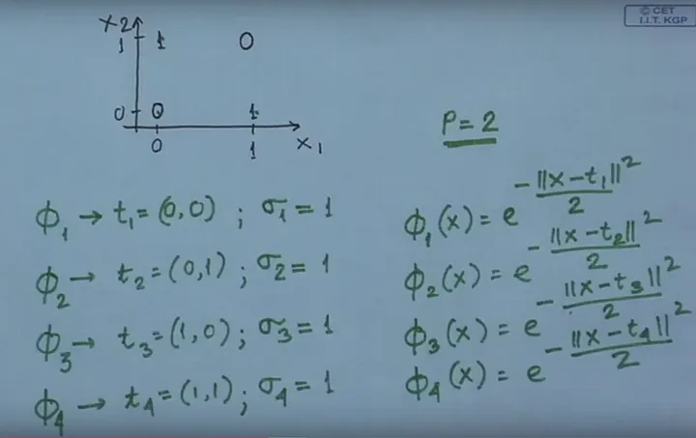

Slide 98
